Slide 1
Bank Management System

Slide 2
Name : Cheeti Viritha
Course : Java Full Stack Development Centre : Bangalore Batch Code : 2021-6138 Enrollment Number : EONFWL443103

Slide 3
Aim
To develop a java project for performing various operations like display , deposit , withdrawal of amount given at runtime.

Slide 4
Introduction
Firstly we have to give customer details as account number , name and amount . After giving the details we will do the multiple operations by using some methods.

Slide 5
Operations
Display All : To display all accounts with details.
Search By Account : Used to search by using account number.
Deposit : To deposit given amount .
Withdrawal : To withdraw an amount.

Slide 6
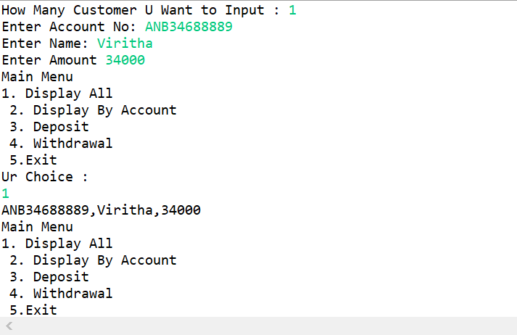
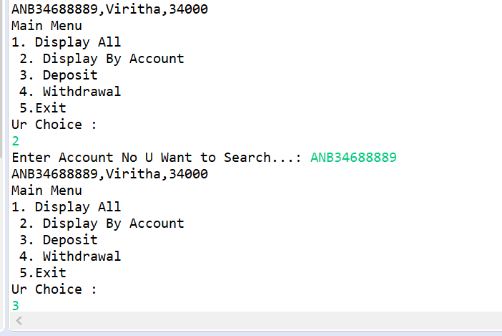
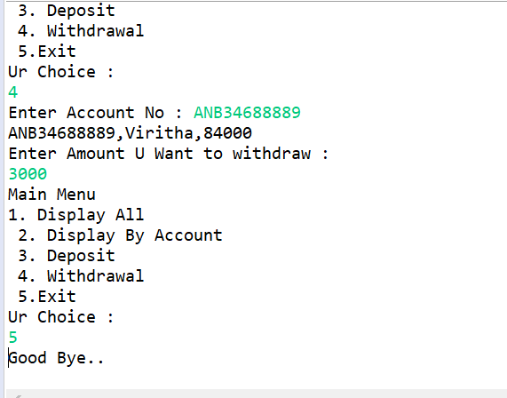
Output images

Slide 7
Thank you

